Slide 1

Predicting Loan Default Risk
A Data-Driven Approach to Advanced Credit Scoring & Analytics
Presented by Ade Arvianto

Slide 2

Biodata
Ade Arvianto
Lived in Depok
I’m experienced in life insurance industry with a specialized focus on actuarial valuation, reinsurance, and reporting. Currently, I am advancing my expertise in Data Science.

Slide 3
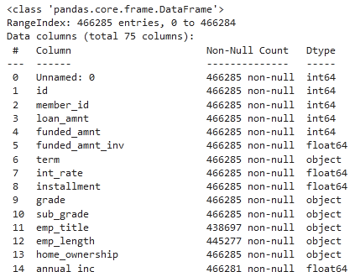
Historical Portfolio Context
Extensive Data Footprint
We processed a massive, historical loan dataset spanning 2007-2014, evaluating over 466,285 unique applicant profiles against 75 comprehensive financial features.
This macro-level analysis enables us to identify robust, statistically significant triggers that historically precede credit default events.
Loan Applicants Evaluated

Slide 4
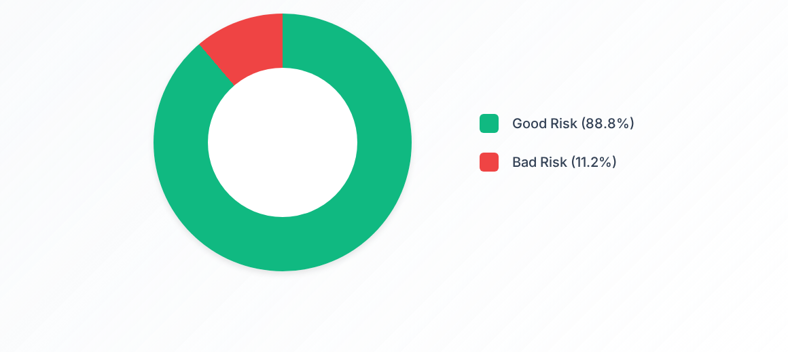
Overall Risk Distribution
The portfolio exhibits heavy class imbalance. To accurately capture the 11.2% minority class (defaulters), stratified sampling and advanced metrics like ROC-AUC are required.

Slide 5
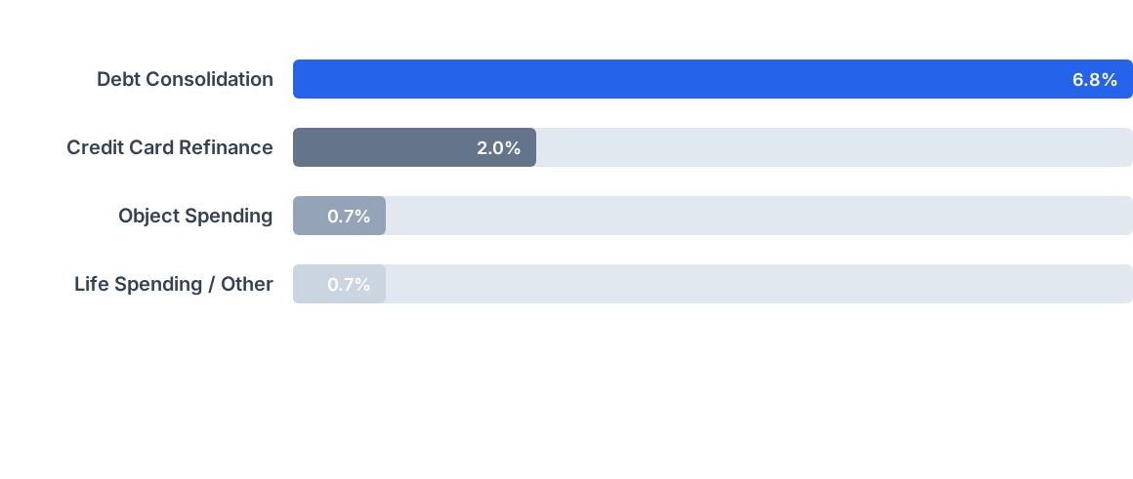
Bad Risk Concentration by Purpose
Debt consolidation is the primary driver of bad risk in the portfolio. Applicants restructuring existing debt show a significantly higher propensity to default compared to transactional borrowers.

Slide 6

Key Demographic Drivers
Term Length: 36-month terms represent the highest absolute volume of defaults, while 60-month terms carry a unique proportional risk profile.
Home Ownership: Over 92% of the applicant base either have a mortgage (51.6%) or are renting (40.4%).
Financial Stability: Mortgage holders and renters display the highest variance in stability, acting as a crucial indicator for algorithmic weighting.
Strategic Focus: Proper stratification across ownership and term-length cohorts is imperative for unbiased model training.

Slide 7
Advanced Predictive Modeling
Transitioning from historical analysis to proactive risk mitigation using optimized Machine Learning architectures.

Slide 8






Data Preprocessing Pipeline
Null Handling
Feature Selection
WOE Encoding
Omitted features exceeding a 50% null threshold. Imputed numerical continuities with medians and categorical gaps with mode frequencies.
Applied correlation heatmaps to eliminate highly colinear variables (Pearson > 0.70), reducing noise and combating algorithmic multicollinearity.
Employed Weight of Evidence (WOE) and Information Value (IV) analysis to transform raw categoricals into statistically predictive, monotonic bins.

Slide 9
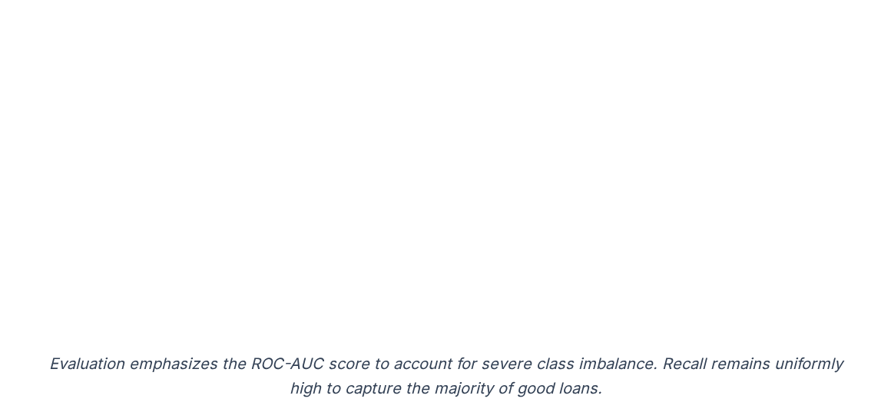
Model Evaluation Matrix
Algorithm | Accuracy | Precision | Recall | ROC-AUC
Random Forest | 0.89 | 0.90 | 0.99 | 0.85
Decision Tree | 0.84 | 0.91 | 0.90 | 0.62
Logistic Regression | 0.88 | 0.89 | 0.99 | 0.59
XGBoost Classifier | 0.89 | 0.90 | 0.99 | 0.86

Slide 10
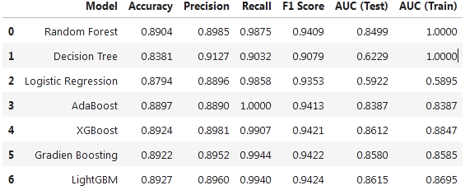
The Champion Model
Precision Meets Scale
Extreme Gradient Boosting (XGBoost) successfully delivered the optimal balance of predictive accuracy and robust class separation.
By heavily penalizing misclassifications of minority 'Bad Risk' loans through its tree-boosting architecture, it minimizes false negatives and actively protects bottom-line capital.
XGBoost ROC-AUC Score

Slide 11


Strategic Execution
Next Steps & Deployment
1. API Integration: Package the XGBoost champion model as a microservice for real-time application scoring.
2. Policy Adjustment: Introduce stricter underwriting prerequisites for 'Debt Consolidation' flagged applicants.
3. Pilot A/B Testing: Route 10% of new traffic through the predictive engine to validate real-world AUC consistency against traditional scorecards.
4. Lifecycle Monitoring: Establish continuous tracking on WOE/IV metrics to detect data drift ahead of macro-economic shifts.

Slide 12
Thankyou

